Slide 1
MINOR PROJECT SEM3
AMRITA CHAUDHURI

Slide 2
AGENDA
Courses completed
The course instructors
​Concepts learnt
Assessments
​Demo project based on skills learnt through Coursera

Slide 3
Introduction
As a part of 25hr video course for doing the mini project in MCA AI Sem3 , below courses I selected and tried to complete.
Structuring Machine Learning Projects by DeepLearning.AI Andrew NG
OBJECTIVE :
Explain why Machine Learning strategy is important
Apply satisficing and optimizing metrics to set up your goal for ML projects
Choose a correct train/dev/test split of your dataset
Define human-level performance
Use human-level performance to define key priorities in ML projects
Take the correct ML Strategic decision based on observations of performances and dataset
Fundamentals of Scalable Data Science IBM
Describe the challenges of data analytics
Describe different methods used for IoT data analysis
Create and deploy a test data generator capable of simulating IoT sensor data coming from a hypothetical washing machine
Apply a solution that captures and stores IoT data from connected devices with Node-Red and Apache ChouchDB NoSQL
Show how to process large data with ApacheSpark
Describe different statistical measures (moments) used in summarizing data
Describe how to process large amount of data arriving in high velocity by using ApacheSpark and SQL
Explain the concept of multi-dimensional vector spaces and how any type of data corpus can be understood as points in that space
Illustrate transformation and basic visualization of data

Slide 4
Continued…
Demonstrate how to plot Diagrams of low dimensional data sets like Box Plot, Run Chart, Scatter Plot and Histogram
Analyze and draw conclusions out of the diagrams you’ve plotted
Analyze and reduce dimensions of your data set
Advanced Machine Learning and Signal Processing IBM
Linear algebra , ML pipeline , statistics , Regression , clustering, SVM, K means
Applied AI with DeepLearning
Demonstrate the ability to execute a saved Keras Model
Recognize the projects within DeepLearning4J
Choose the proper Framework for DeepLearning
Describe the tools used to get a model from Keras into DL4J

Slide 5
Instructors
Andrew Ng is Founder of DeepLearning.AI, General Partner at AI Fund, Chairman and Co-Founder of Coursera, and an Adjunct Professor at Stanford University.
Romeo Kienzler Chief Data Scientist and course lead, holds a M. Sc. (ETH) in Information Systems, Bioinformatics & Applied Statistics (Swiss Federal Institute of Technology). He has nearly two decades of experience in Software Enineering, Database Administration and Information Integration. Since 2012 he works as a Data Scientist for IBM.
Nikolay Manchev holds an MSc in Software Technologies, an MSc in Data Science, and is currently undertaking postgraduate research at King's College London. His area of expertise is Machine Learning and Data Science, and his research interests are in neural networks with emphasis on biological plausibility.

Slide 6
Overview of IOT data analysis different ml algorithms both supervised and unsupervised neural network linear algebra and statistics data preprocessing hyperparameter tuning
Concepts learnt

Slide 7
Assessments
Generate data with IoT data storage calculator for IBM cloud-->create a test data generator using Node-red→
Publishing data to Watson IOT platform-->Implement a flow to subscribe to this data and store it in Nosql DB[Apache CouchDB(Cloudant)] --> creating a function which is used to create a data frame from a cloudant data frame using the "DataSource" which is some sort of a plugin which allows ApacheSpark to use different data sources.-->then passed the dataframe object. also registered the dataframe in the ApacheSparkSQL catalog --> issue queries against the "washing" table using "spark.sql()-->implement a function which returns a (python) list of string values of the field names in this data frame--> connect to the cloudant database --> test the created functions
For each module separate lab was there both for practice and graded submission
1. generate sensor data-->https://github.com/IBM/coursera/raw/master/coursera_ml/a2.parquet---> analysing the data using spark-->creating a VectorAssembler which consumes columns X, Y and Z and produces a column “features”\n"--> instantiate a classifier from the SparkML package and assign it to the classifier variable-->Rename the “CLASS” column to “label”-->Specify the label-column correctly to be “CLASS”-->train and evaluate-->submit.
2. Again load parquet file-->check if we have balanced classes – this means that we have roughly the same number of examples for each class we want to predict which is also important for classification and clustering -->create a VectorAssembler which consumes columns X, Y and Z and produces a column “features”--> insatiate a clustering algorithm from the SparkML package and assign it to the clust variable-->from clustering import Kmeans-->from pyspark import pipeline--> fit the model and predict

Slide 8
DEMO project based on skills learnt
Mammography is the most effective method for breast cancer screening
available today. However, the low positive predictive value of breast
biopsy resulting from mammogram interpretation leads to approximately
70% unnecessary biopsies with benign outcomes.
This data set can be used to predict the severity (benign or malignant)
of a mammographic mass lesion from BI-RADS attributes and the patient's age.
It contains a BI-RADS assessment, the patient's age and three BI-RADS attributes
together with the ground truth (the severity field) for 516 benign and
445 malignant masses that have been identified on full field digital mammograms
collected at the Institute of Radiology of the
University Erlangen-Nuremberg between 2003 and 2006.
https://archive.ics.uci.edu/ml/datasets/Mammographic+Mass

Slide 9
This data contains 961 instances of masses detected in mammograms, and contains the following attributes:
BI-RADS assessment: 1 to 5 (ordinal)
Age: patient's age in years (integer)
Shape: mass shape: round=1 oval=2 lobular=3 irregular=4 (nominal)
Margin: mass margin: circumscribed=1 microlobulated=2 obscured=3 ill-defined=4 spiculated=5 (nominal)
Density: mass density high=1 iso=2 low=3 fat-containing=4 (ordinal)
Severity: benign=0 or malignant=1 (binominal)
BI-RADS is an assesment of how confident the severity classification is; it is not a "predictive" attribute and so we will discard it. The age, shape, margin, and density attributes are the features that we will build our model with, and "severity" is the classification we will attempt to predict based on those attributes.
Although "shape" and "margin" are nominal data types, which sklearn typically doesn't deal with well, they are close enough to ordinal that we shouldn't just discard them. The "shape" for example is ordered increasingly from round to irregular.
A lot of unnecessary anguish and surgery arises from false positives arising from mammogram results. If we can build a better way to interpret them through supervised machine learning, it could improve a lot of lives.
Apply several different supervised machine learning techniques to this data set, and see which one yields the highest accuracy as measured with K-Fold cross validation (K=10). Apply:
Decision tree
Random forest
KNN
Naive Bayes
SVM
Logistic Regression
a neural network using Keras.
The data needs to be cleansed; many rows contain missing data, and there may be erroneous data identifiable as outliers as well.
For SVM it is required the input data to be normalized first.

Slide 10
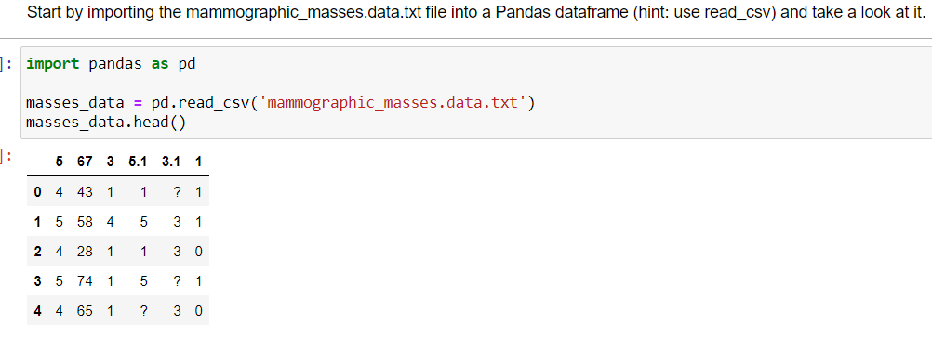
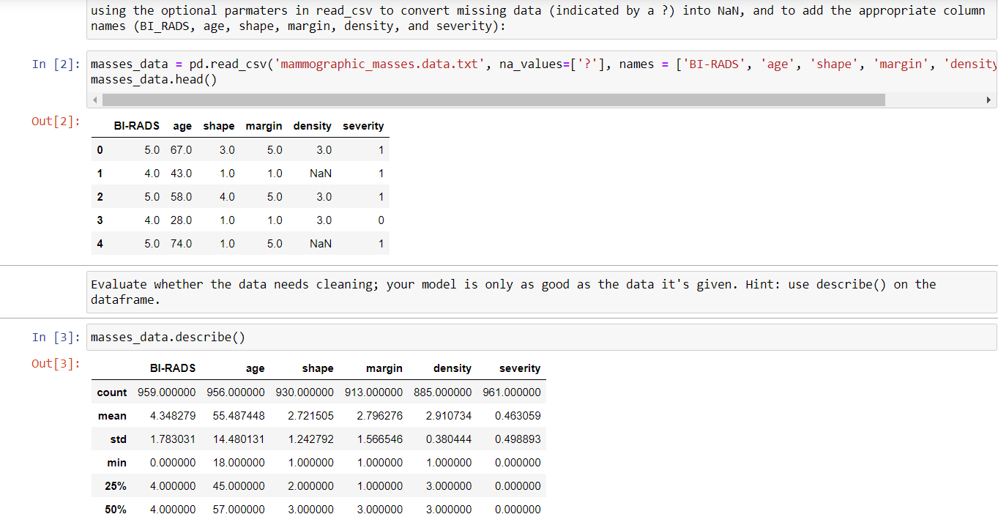

Slide 11
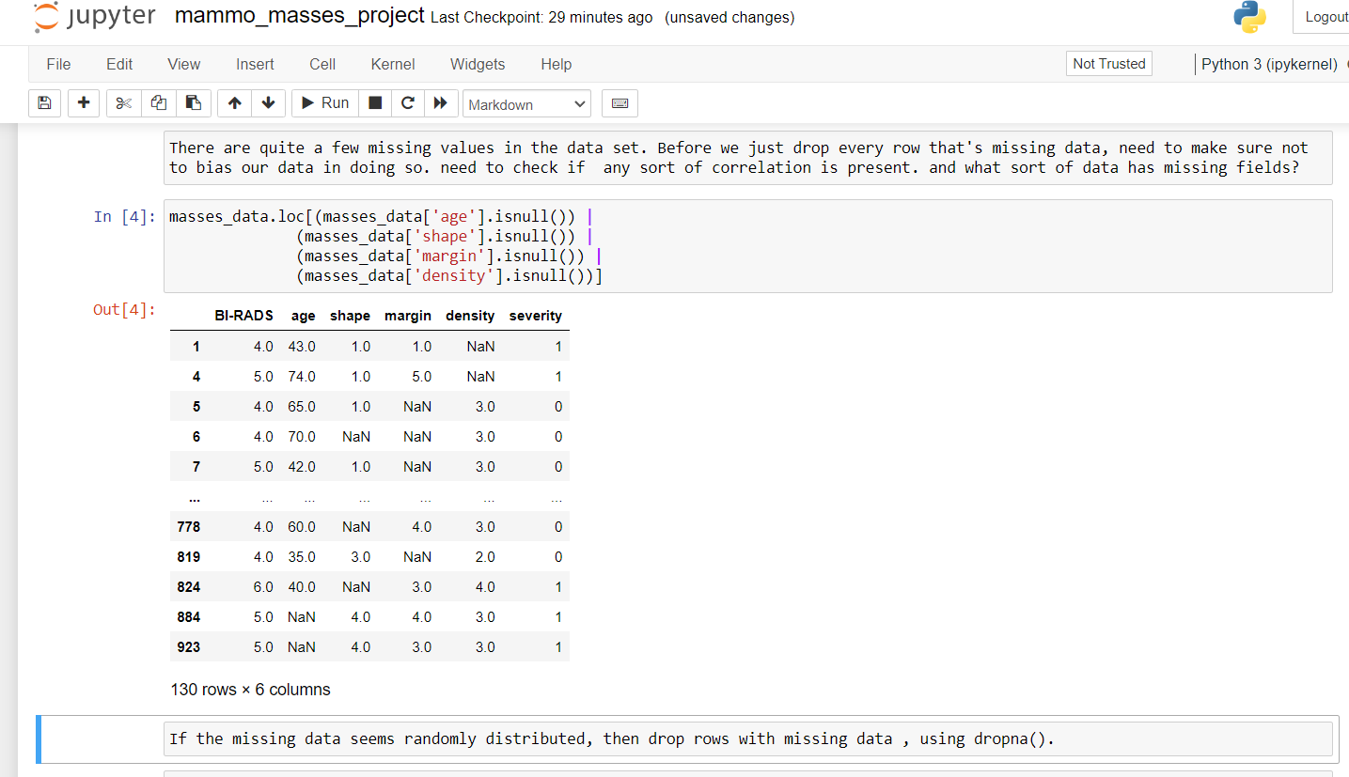

Slide 12
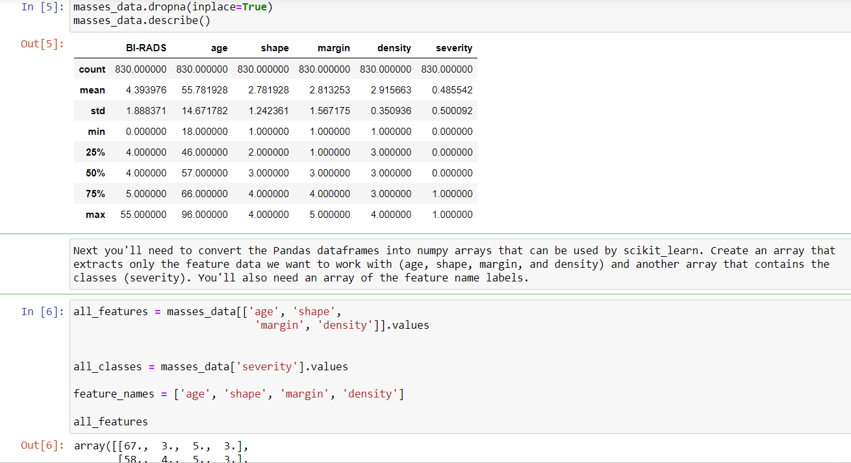

Slide 13
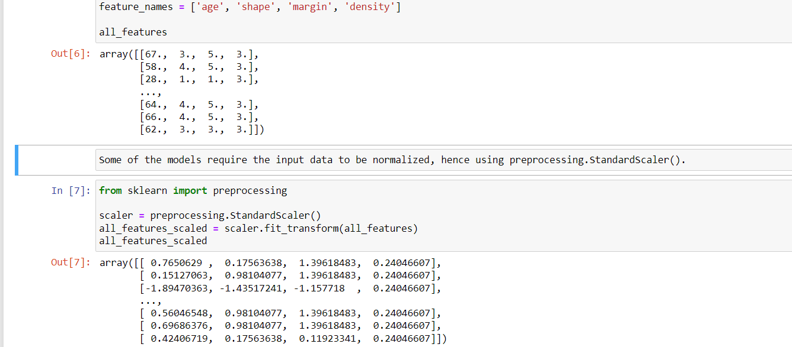

Slide 14
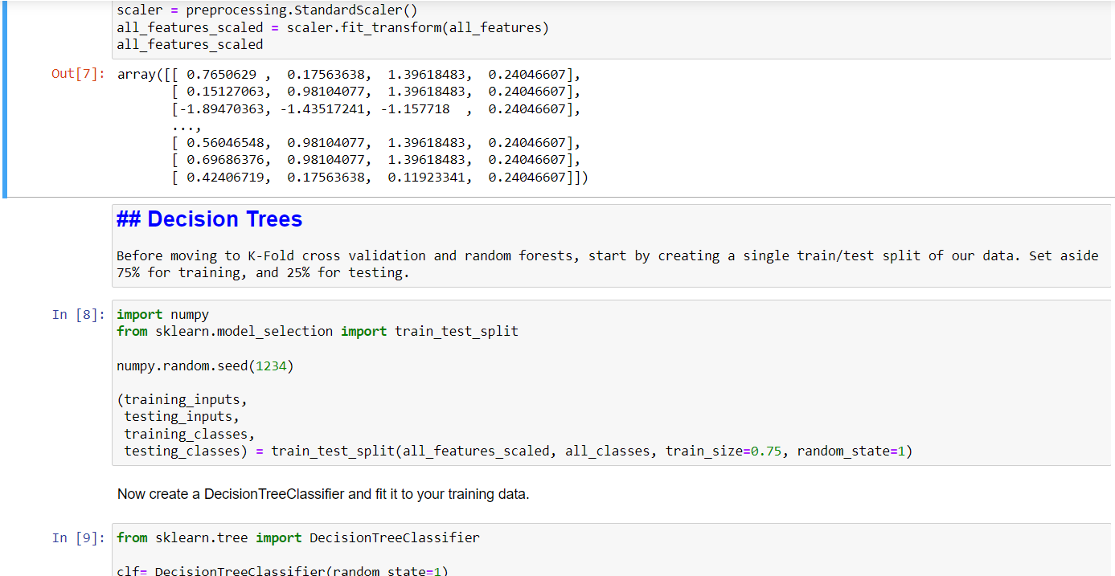

Slide 16
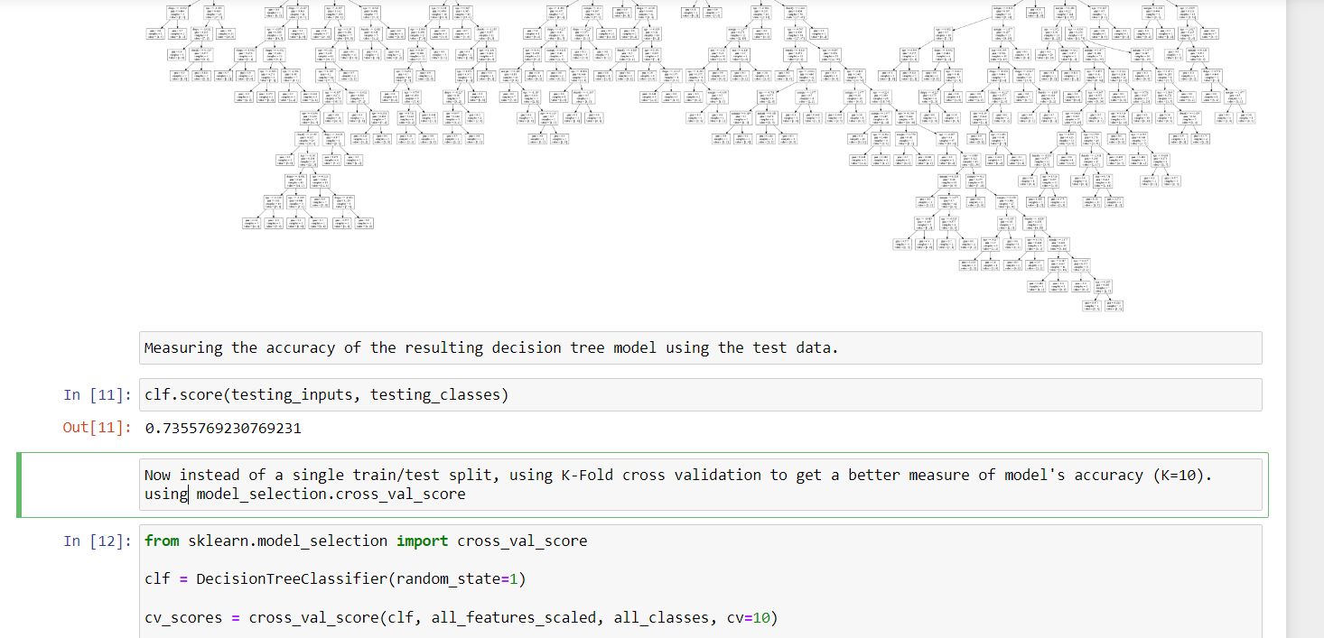

Slide 17
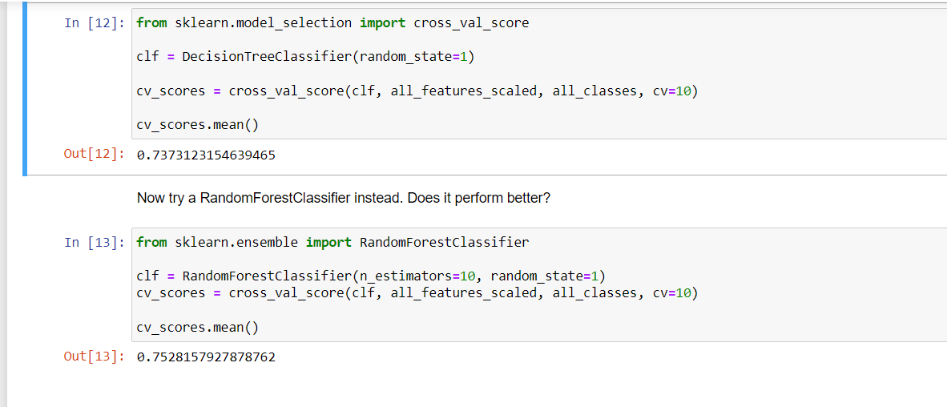

Slide 19
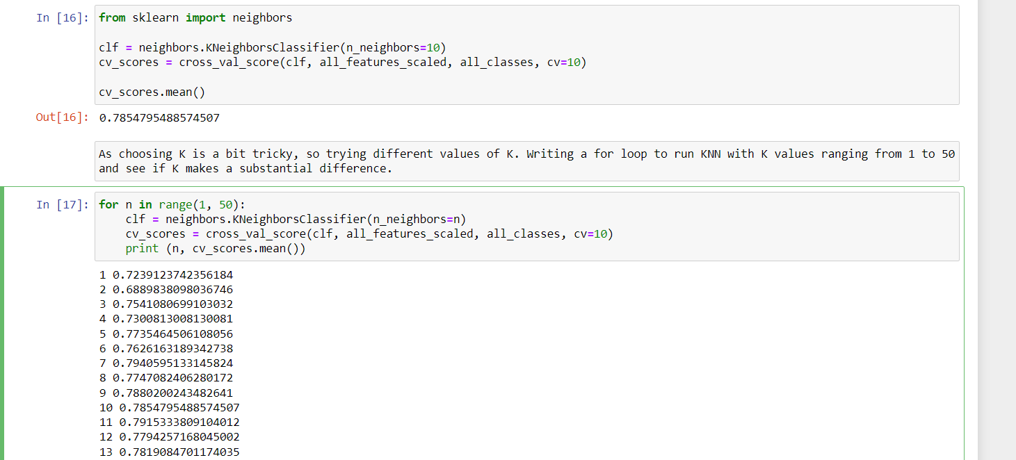

Slide 20
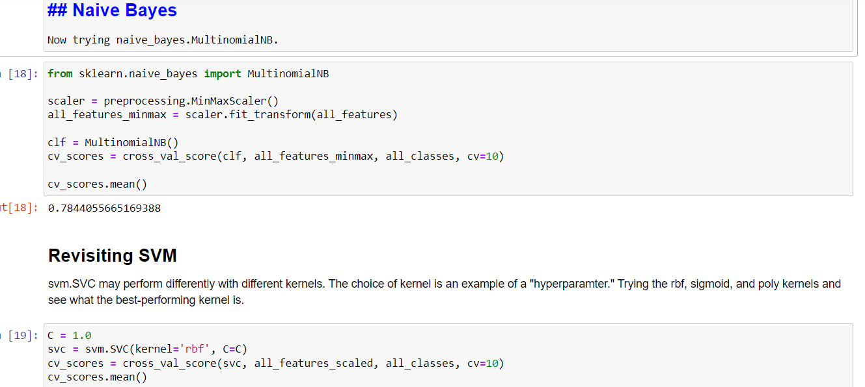

Slide 21
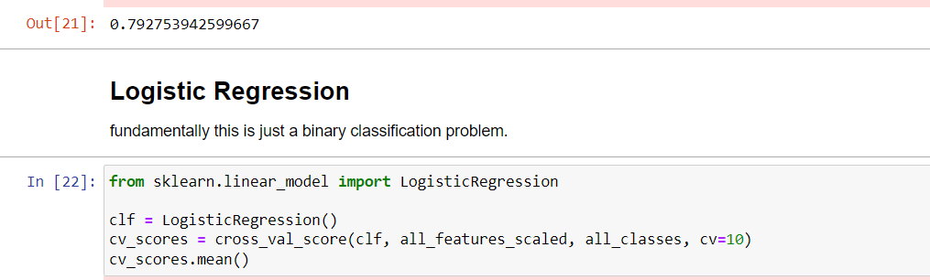
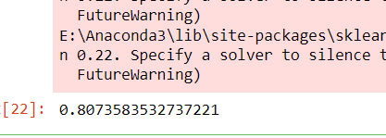

Slide 22
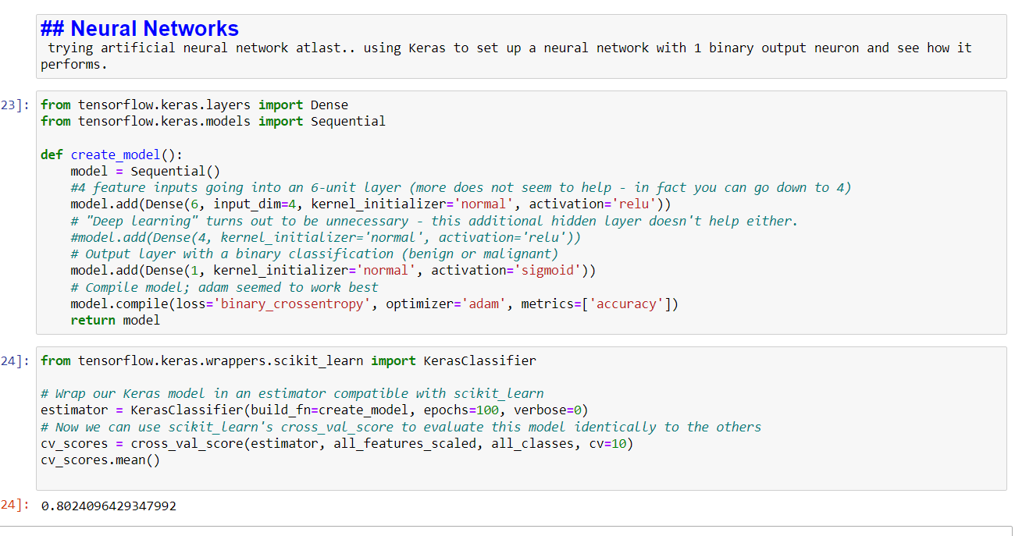

Slide 23
